Slide 1
Cyclistic Bike-Share Analysis
Member vs Casual Rider Behavior
Goal:
Understand behavioral differences between member and casual riders to support growth & retention strategies.
Executive Summary:
Members drive the majority of platform usage, accounting for 65% of total rides, while casual riders represent a meaningful growth segment. Casual riders exhibit longer ride durations, suggesting leisure-oriented usage patterns. Electric bikes demonstrate stronger demand across both segments. Ride activity follows clear seasonal trends, with demand peaking mid-year. These patterns reveal opportunities for membership conversion, pricing optimization, and fleet strategy adjustments.

Slide 2
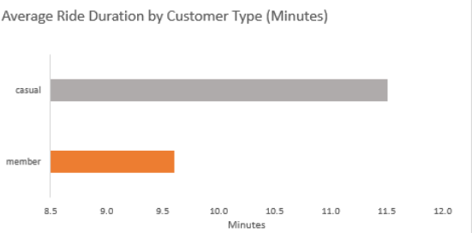
Key Insights:
Casual riders demonstrate longer ride durations, indicating leisure-oriented usage patterns, while members show shorter rides consistent with routine or commute behavior.
Recommendations:
Target high-duration casual riders with personalized membership incentives.
Highlight cost advantages associated with frequent or extended usage.
Introduce cost-efficient time-based packages within membership plans

Slide 3
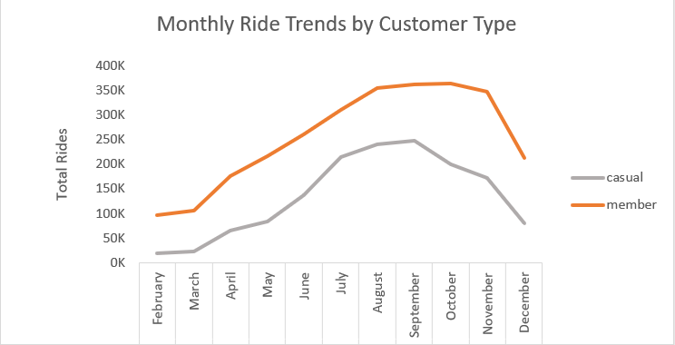
Key Insights:
Ride activity for both members and casual riders shows strong seasonality, with demand rising through mid-year, peaking in late summer and declining sharply toward winter months
Recommendations:
Concentrate conversion and engagement campaigns ahead of peak demand periods, Introduce targeted membership incentives such as trial offers, upgrade discounts, and usage-based rewards.
Deploy seasonal membership incentives during low-demand months to stabilize ridership and reduce revenue fluctuations

Slide 4
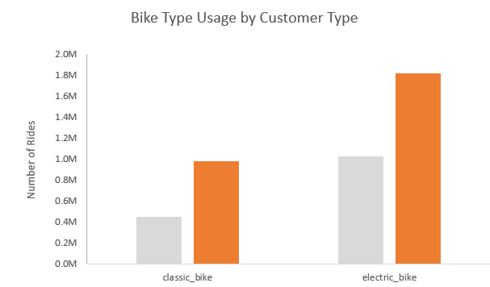
Key Insight:
Electric bikes generate higher ride volumes across both customer types, indicating stronger user preference compared to classic bikes.
Recommendations:
Prioritize expansion and allocation of the electric bike fleet.
Leverage electric bike demand as a membership value driver through exclusive or priority access benefits

Slide 5
Final Recommendations & Strategic Direction
Observed behavioral and demand patterns suggest that growth can be driven through:
Targeted casual-to-member conversion strategies
Demand-aligned fleet investments
Seasonally adaptive pricing and marketing initiatives
These initiatives collectively support sustainable usage growth, improved asset utilization, and stronger customer value delivery.

